Slide 1
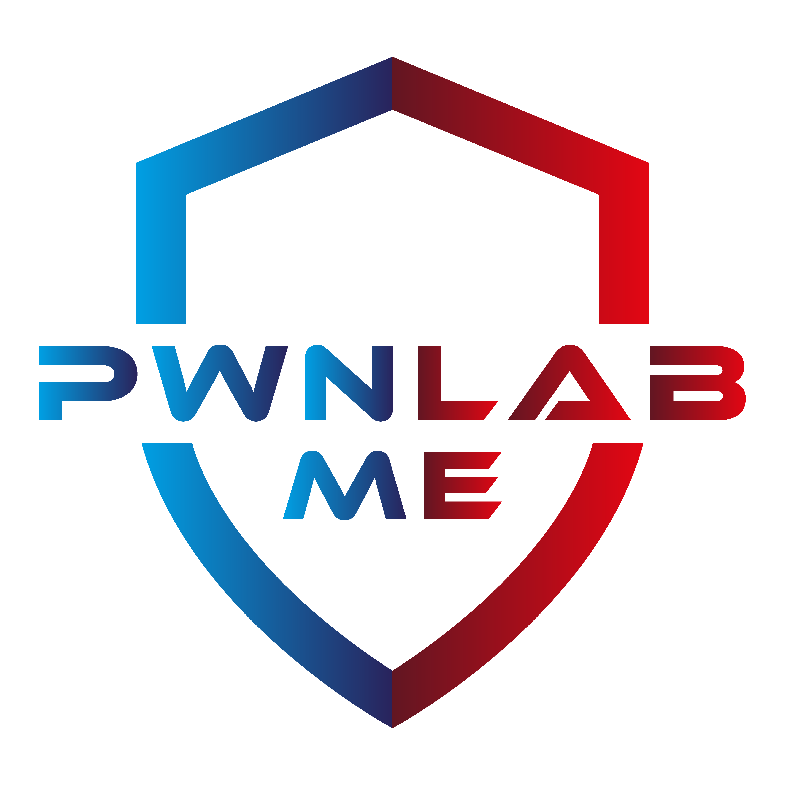
Smart Contract Attacks & Ways To Prevent
Deniz Baş | PwnLab.Me Core Member

Slide 2
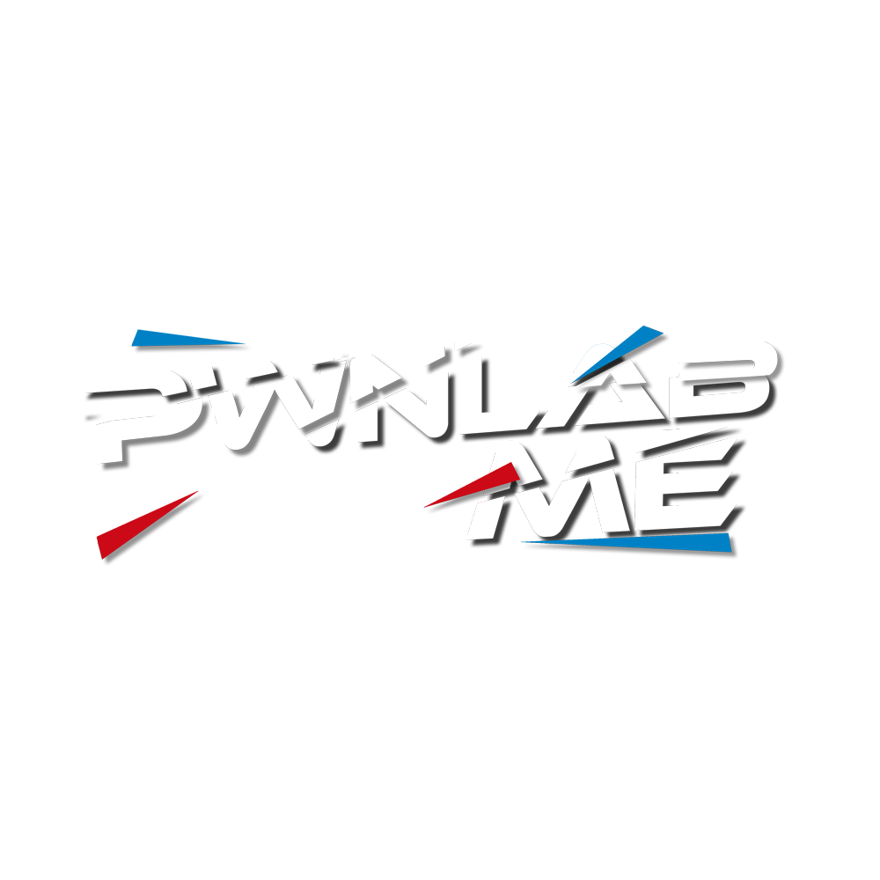
Content
$whoami
What Are Smart Contracts?
Hello World! ~ Solidity
Phising Attack With “tx.origin”
Self-Destruct Attack
DoS Attack
Re-Entrancy Attack
Arithmetic Overflow and Underflow Attack

Slide 3
$whoami
:)
2005 model
github.com/0x471
twitter.com/d0x471b

Slide 4
What are smart contracts?
Programs stored on a blockchain
They’re temper-proof, no one can change the codes
They’re automatic, no need for human intervention
Solidity is a programming language for implementing smart contracts on various blockchains.

Slide 5
Hello World! ~ Solidity
// SPDX-License-Identifier: MIT
pragma solidity ^0.8.13;
contract HelloWorld {
string public greet = "Hello World! -PwnLabMe“;
}

Slide 6
phising with tx.origin

Slide 7
self-destruct attack

Slide 8
DoS attack

Slide 9
re-entrancy attack

Slide 10
arithmetic overflow and underflow attack

Slide 11
Thanks for listening :)

